Slide 1
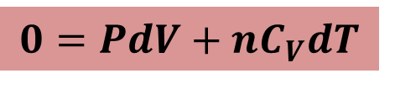

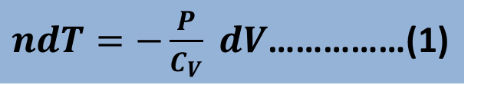
Relation Between P and V in Adiabatic Expansion
We consider n mole of gas increasing its volume by a differential amount dV at constant pressure.
From the 1st law of thermodynamics,
$$∆Q=∆W+∆E$$
$$0=PdV+nC_{V}dT$$
$ndT=−\frac{P}{C_{V}} dV$……………(1)

Slide 2


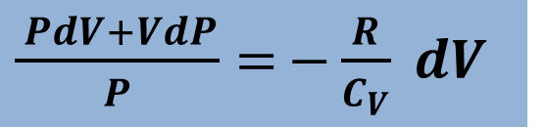
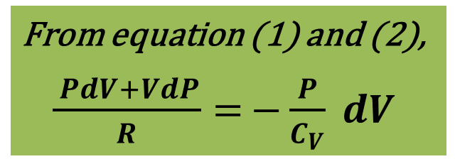
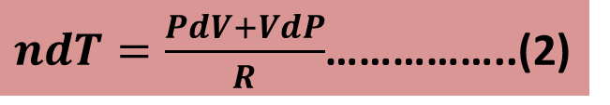
Again,
$$PV=nRT$$
$$PdV+VdP=nRdT$$
$ndT=\frac{PdV+VdP}{R}$……………..(2)
From equation (1) and (2),
$\frac{ PdV+VdP}{R}=$ $−\frac{P}{C_{V}} dV$
$\frac{ PdV+VdP}{P}=$ $−\frac{R}{C_{V}} dV$

Slide 3





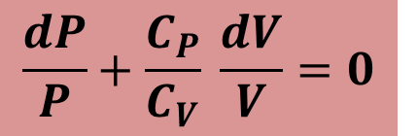
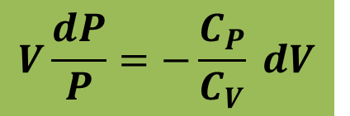
$\frac{ PdV+VdP}{P}=$ $−\frac{C_{P}−C_{V}}{C_{V}} dV$
$$dV+V\frac{dP}{P}=−\frac{C_{P}}{C_{V}} dV+dV$$
$$V\frac{dP}{P}=−\frac{C_{P}}{C_{V}} dV$$
$$\ln{PV^{γ}=Constant}$$
$$\frac{dP}{P}+\frac{C_{P}}{C_{V}} \frac{dV}{V}=0$$
$∴$ $PV^{γ}=Constant$
$$\ln{P+γ\ln{V=Constant}}$$

Slide 4
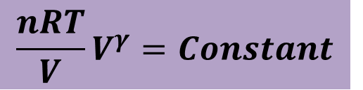


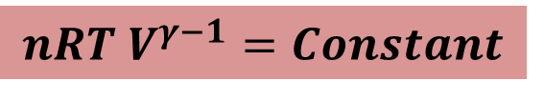
Relation Between T and V in Adiabatic Expansion
We know,
$$PV^{γ}=Constant$$
$$\frac{nRT}{V}V^{γ}=Constant$$
$$nRT{ V}^{γ−1}=Constant$$
$$T{ V}^{γ−1}=Constant$$

Slide 5


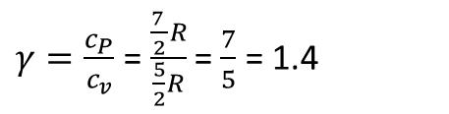
54. We know that for an adiabatic process pV^{γ} = a constant. Evaluate “a constant” for an adiabatic process involving exactly 2.0 mol of an ideal gas passing through the state having exactly p = 1.0 atm and T = 300 K. Assume a diatomic gas whose molecules rotate but do not oscillate.
Here, n = 2 mol
P = 1.0 atm = 1.0x10⁵ Pa
T = 300 K
Diatomic gas whose molecules rotate but do not oscillate, f = 3+2 = 5
C_{V} = ($\frac{f}{2})R=$ ($\frac{5}{2})R$
C_{p} – C_{V} = R
C_{p} = C_{V} + R = ($\frac{5}{2})R$ + R = ($\frac{7}{2})R$
$γ=\frac{c_{P}}{c_{v}}$ =$\frac{\frac{7 }{2}R}{\frac{5}{2}R}$ = $\frac{7}{5}$ = 1.4

Slide 6



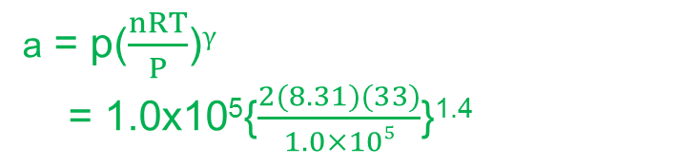
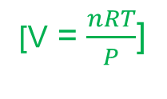
p$V^{γ}$ = constant
a = p$V^{γ}$
[Ideal gas equation, pV = nRT]
a = p($\frac{nRT}{P}$)$γ$
= 1.0x10⁵{$\frac{2(8.31)(33)}{1.0×105}$}^{1.4}
[V = $\frac{nRT}{P}$]
= 1.0x10⁵{0.04986}^{1.4}
a =1.5x10⁵ Nm^{2.2}
Unit of a = ($\frac{N}{m^{2}}$)($m^{3}$)$γ$ = N($\frac{m^{3γ}}{m^{2}}$) = $Nm^{3γ−2}$ = $Nm^{3\left(1.4\right)−2 }$= $Nm^{4.2−2.0 }$
a = $Nm^{2.2}$

Slide 7



55. A certain gas occupies a volume of 4.3 L at a pressure of 1.2 atm and a temperature of 310 K. It is compressed adiabatically to a volume of 0.76 L. Determine (a) the final pressure and (b) the final temperature, assuming the gas to be an ideal gas for which γ = 1.4.
Here, V_{i} = 4.3 L
p_{i} = 1.2 atm = 1.2x10⁵ Pa
T_{i} = 310 K
V_{f} = 0.76 L
$γ$ = 1.4
(a) p$V^{γ}$ = constant
p_{i}${Vi}^{γ}$ = p_{f}${Vf}^{γ}$
$\text{p}\text{f}=\frac{\text{p}\text{i}{Vi}^{γ}}{{Vf}^{γ}}$ =p_{i}( $\frac{{Vi}^{γ}}{{Vf}^{γ}}$) = ${p_{i}(\frac{V_{i}}{V_{f}})}^{γ}$ = ${\text{1.2}\text{x}\text{105}(\frac{\text{4.3 }\text{L}}{\text{0.76 }\text{L}})}^{1.4}$ $=\text{1.2}\text{x}\text{105(11.3166)}$= $\text{1.36}\text{x}\text{106 }\text{Pa}$

Slide 8


(b) T_{i}${Vi}^{γ−1}$ = T_{f}${Vf}^{γ−1}$
T_{i}${Vi}^{γ−1}$ = T_{f}${Vf}^{γ−1}$
T_{f} = $\frac{\text{T}\text{i}{Vi}^{γ−1} }{{Vf}^{γ−1}}$ = ${T_{i}(\frac{V_{i}}{V_{f}})}^{γ−1}$ = ${\text{310}(\frac{\text{4.3 }\text{L}}{\text{0.76 }\text{L}})}^{1.4−1}$ = 310(2.00) = 620 K

